Slide 1
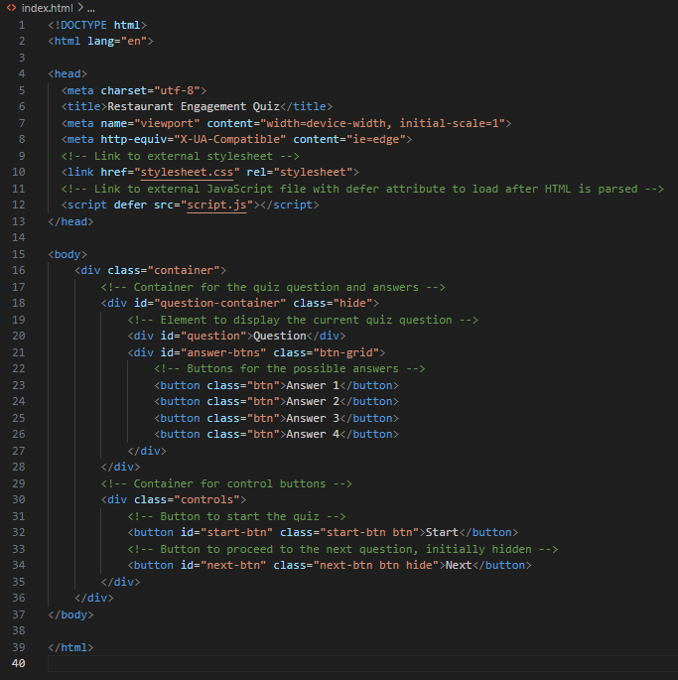
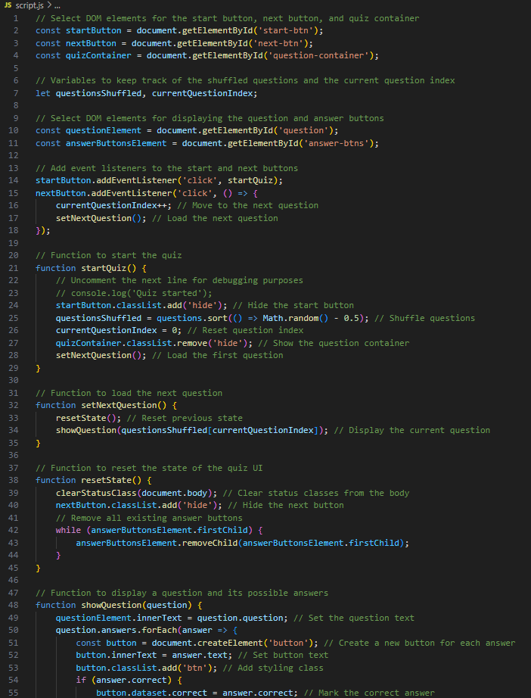
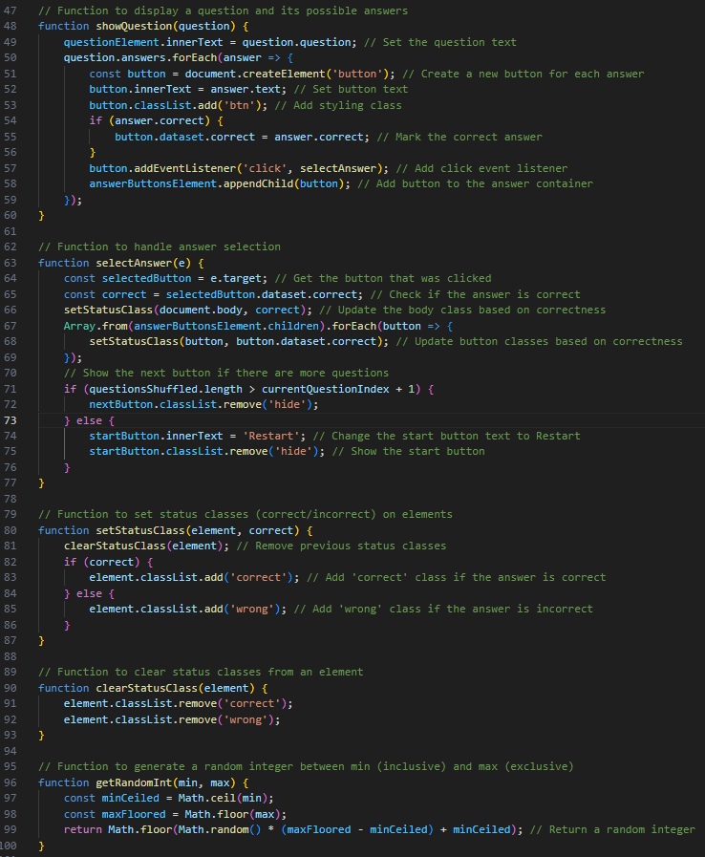
Quiz App Workings
This portion of the application is a quiz interface designed to test users' knowledge about a restaurant. It consists of three main files: HTML for structure, CSS for styling, and JavaScript for interactivity.

Slide 2
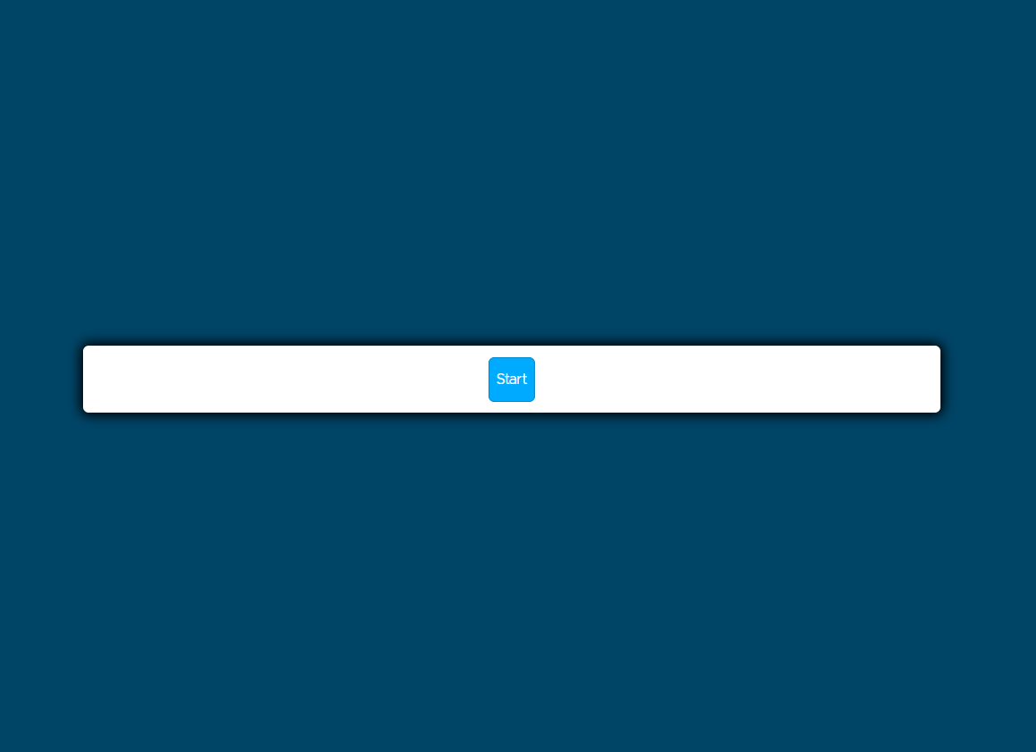
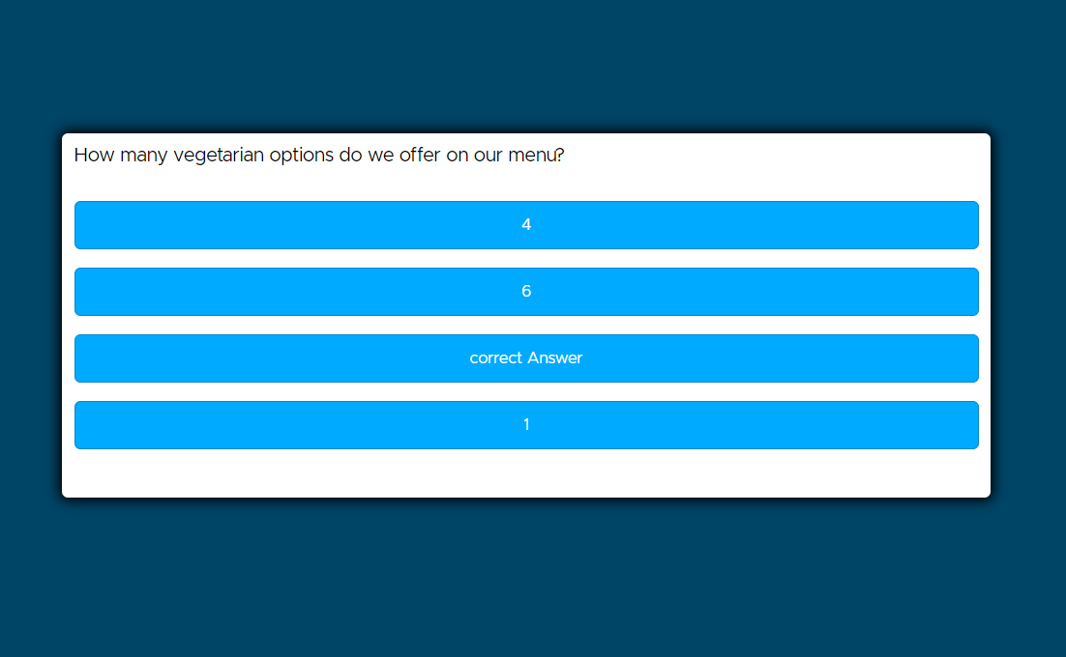
When the user visits the page, the HTML provides the basic layout and elements for the quiz. Initially, only the "Start" button is visible. When clicked, the JavaScript file's startQuiz function initializes the quiz, shuffles the questions, and displays the first question along with answer buttons.

Slide 3
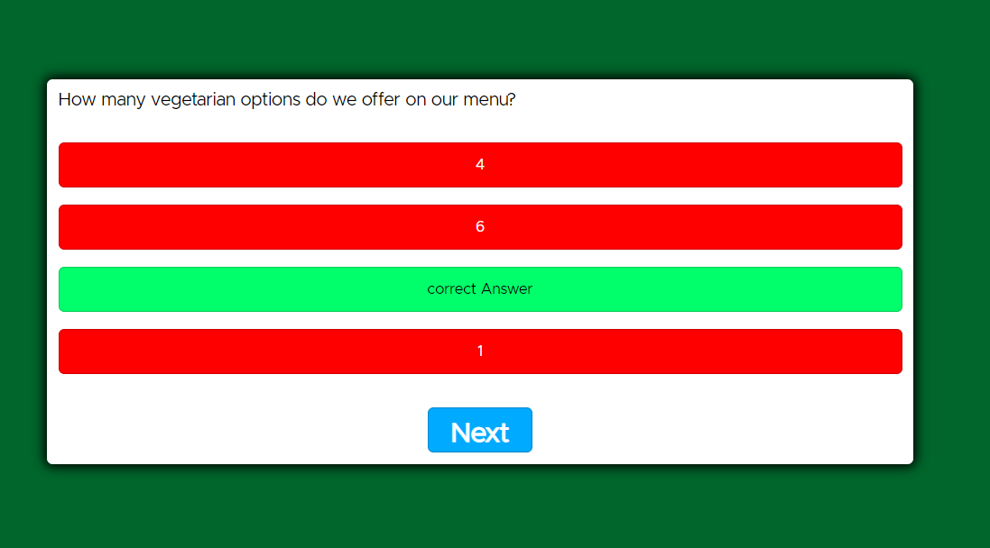
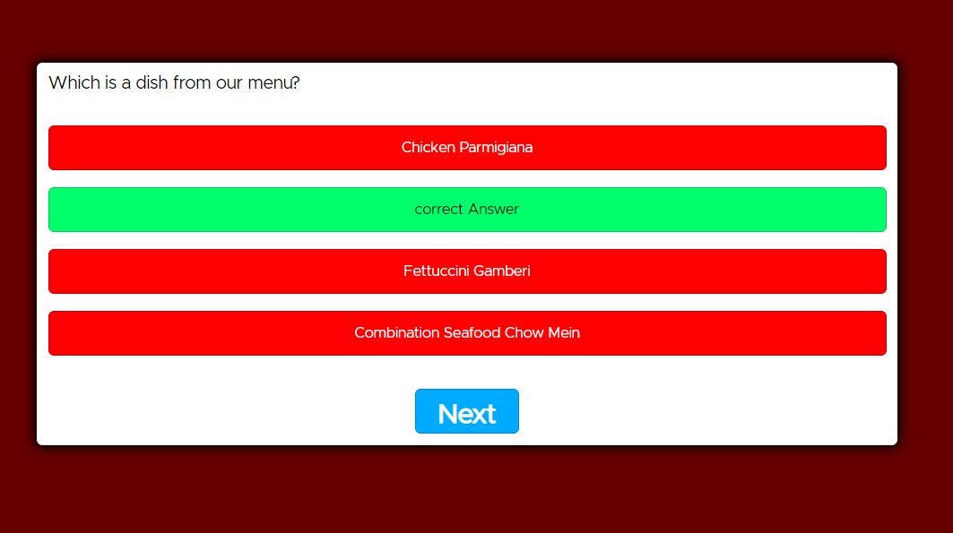
As users interact with the answer buttons, the JavaScript evaluates their choices and updates the UI to indicate whether the selected answer is correct or incorrect. The background color of the page changes based on the answer's correctness, thanks to CSS styling applied through JavaScript.
Users can move to the next question by clicking the "Next" button, which becomes visible after answering a question.

Slide 4
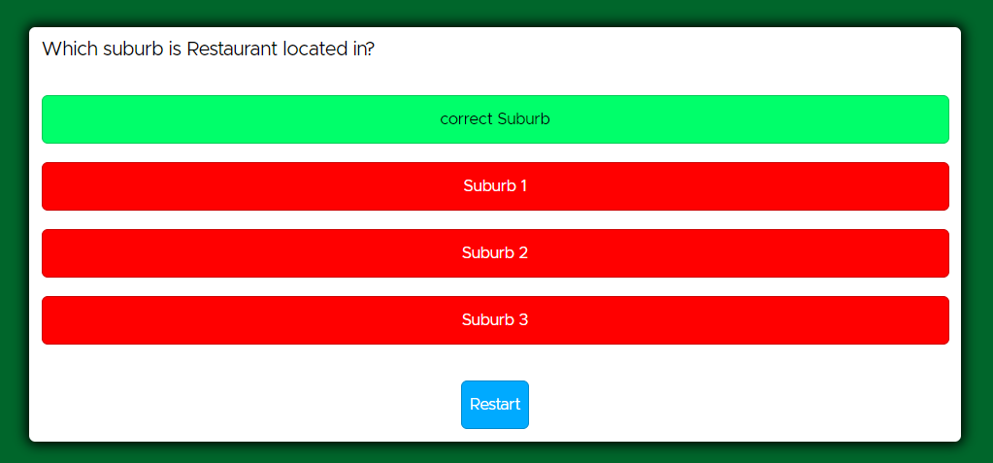
Once all questions are answered, the "Start" button text changes to "Restart," allowing users to retake the quiz.

